Slide 1

An earthquake has occurred! There are many victims who have lost a lot of blood.
I need your help URGENTLY to perform blood transfusions!

Slide 2
You need to exercise caution when performing this task.
Any mistake made can cause the patients to develop serious reactions such as high fever, kidney failure or shock. Some of these reactions can lead to death!

Slide 3
Before you get started, let’s go for some training using the simulated scenarios in
Rescue Mission.exe.
In this program, you would learn the condition necessary for successful blood transfusions.

Slide 4
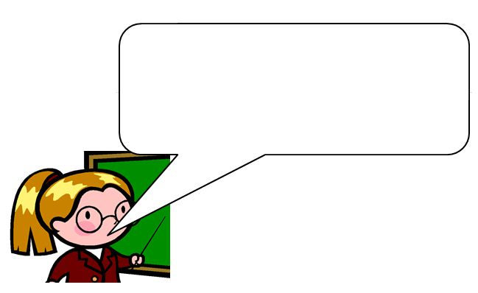
Your challenge for the day!
With the help of Rescue Mission.exe, examine:
the essential difference between each person’s blood type.
why certain combinations of donor and recipient blood types are not suitable for blood transfusion.
You need to be able to explain the two points above and to clear all stages in
Rescue Mission.exe in order to pass the training.

